Slide 1
North County Soccer Park Ages 5-11 Activities STEM Slides
Kevin Bowen
President Porpoise Robotics
kbowen6@icloud.com
This document is proprietary. It is to be used in conjunction with Porpoise Robotics lessons.
No part of this document may be copied in any manner to a third party without the prior written consent of Porpoise Robotics

Slide 2
Find the Target (up to five systems)
Target
Waypoints
Personal Computer
ESP-32 with ESP Now
WiFi to WiFi Comms
Obstacles
Target
Map of Field
Vehicle location
Vehicle Waypoints
Range to Target
Range to Obstacle
Bluetooth
Controller
Pathfinder
Vehicles
The student will turn on the computer and see the map of the Field, the vehicle status and range to target
The student will turn on the vehicle, link to the controller and see the camera image and if there are targets in range
The student will drive the car to the waypoint to the target or freeform to the target while avoiding obstacles.
The student will close to the target and capture with grippers, then return to base.

Slide 3
Find the Target
Pathfinder Gen 3Vehicle
Personal Computer
ESP-32 with ESP Now
WiFi to WiFi Comms
Map of Field
ESP-32 Dev Module
with ESP Now
WiFi to WiFi Comms
GPS
Direct
WiFi to WiFi
Range Finder
Vehicle location
Vehicle Waypoints
Target
Gripper
16 LEDs
Camera Image
Bluetooth
Controller
ESP-32 Dev Module Vehicle Bluetooth Control
Bluetooth RF Comms
Router 2.4G (Alvi)
Web Cam with ESP-32 Wrover

Slide 4
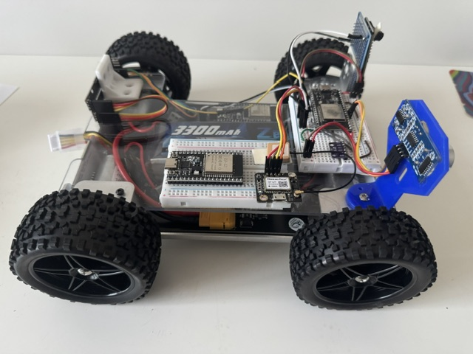
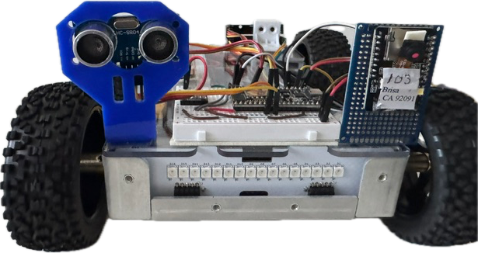
Find the Target Gen 3 Vehicle

Slide 5
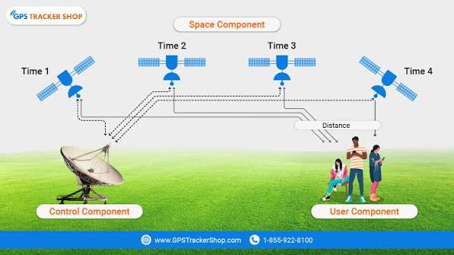
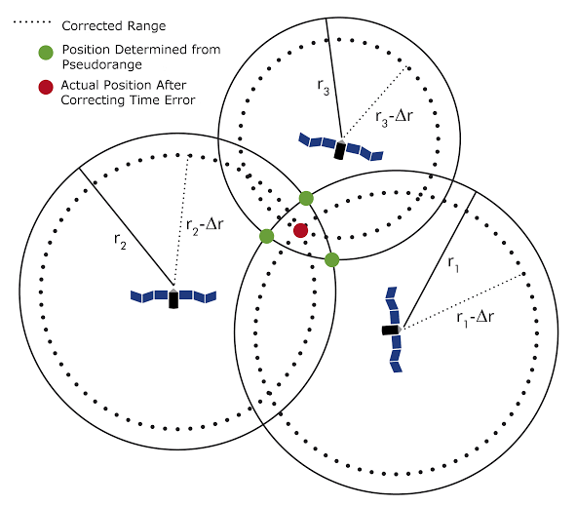
Global Positioning System
One satellite possible locations
GPS works by measuring your distance from at least four satellites orbiting Earth.
The receiver calculates how long a radio signal takes to travel from
the satellite to your device and multiplies it by the speed of light.
This creates an invisible sphere of possible locations around each satellite. [1, 2]
How GPS Works Simplified 9min https://www.youtube.com/watch?v=AlHPDRQ08jU
How does GPS Navigation Work 9min https://www.youtube.com/watch?v=PaxinQDZUVM
How does GPS Work 17 minutes https://www.youtube.com/watch?v=qPTIi7Ds15M

Slide 6
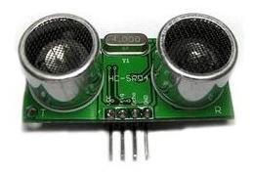
Ultrasonic Range Finder
The Ping Sensor, also known as an Ultrasonic Ranger, can be used to measure the distance from the sensor to the closest object to the sensor. A typical device, the HC-SR04 contains two ultrasonic transducers, one to transmit from and one to receive with, a transmit pulse generator, a receiver, interference filter and timing logic.
To take a measurement we send the sensor a pulse and wait for a response. When we pulse the sensor it sends out a burst of eight 40kHz pulses on the transmitter and starts looking for the echo of those pulses on the receiver. When the receiver detects the echo, it sends us a signal. The width of the return pulse is proportional to the distance to the object. The delay from the pulse we send out, to the return pulse, is the amount of time it takes for sound to travel out from the sensor, to the object, and back. Knowing the speed of sound, which is 1126 ft/sec, or 343 m/s, the distance can be calculated.

Slide 7
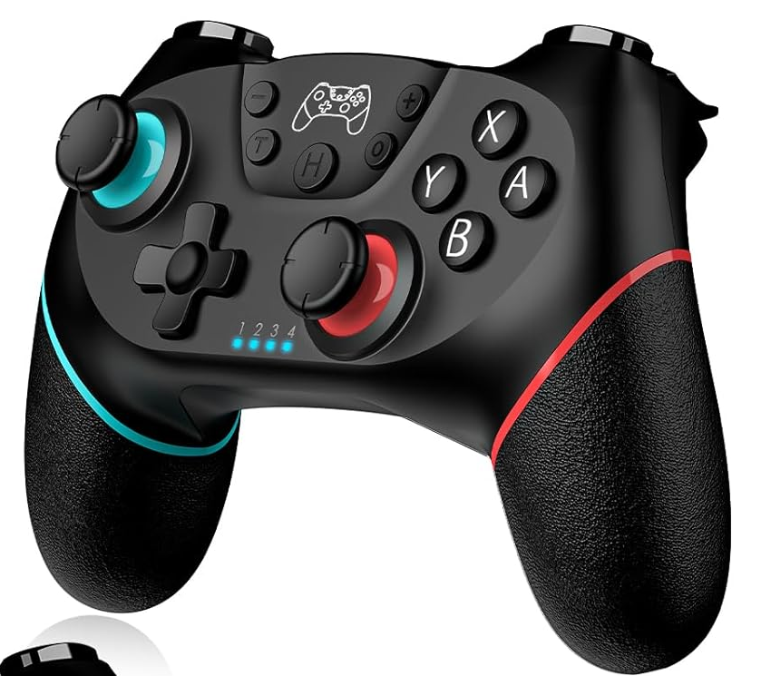
Nintendo Switch Controller
The Nintendo controller has all the features of the PS3 plus it does not have to determine its MAC address before pairing to a vehicle
It is charged via a 5V DC wall plug to the controller via a ‘C’ cable connector. The charge lasts much longer than the PS3
To Pair the controller with a Pathfinder Gen 3 vehicle, connect you ESP-32 to a PC.
Open any Arduino program and select the ESP-32 Dev Board and the correct port.
Open the Serial Monitor and type ‘pair’ into the inut line and hit return.
On the controller, select ‘A” and ‘Home”. The vehicle will link to the controller and the monitor will print the controller MAC address. The address is not necessary, as the program will remember to controller.

Slide 8
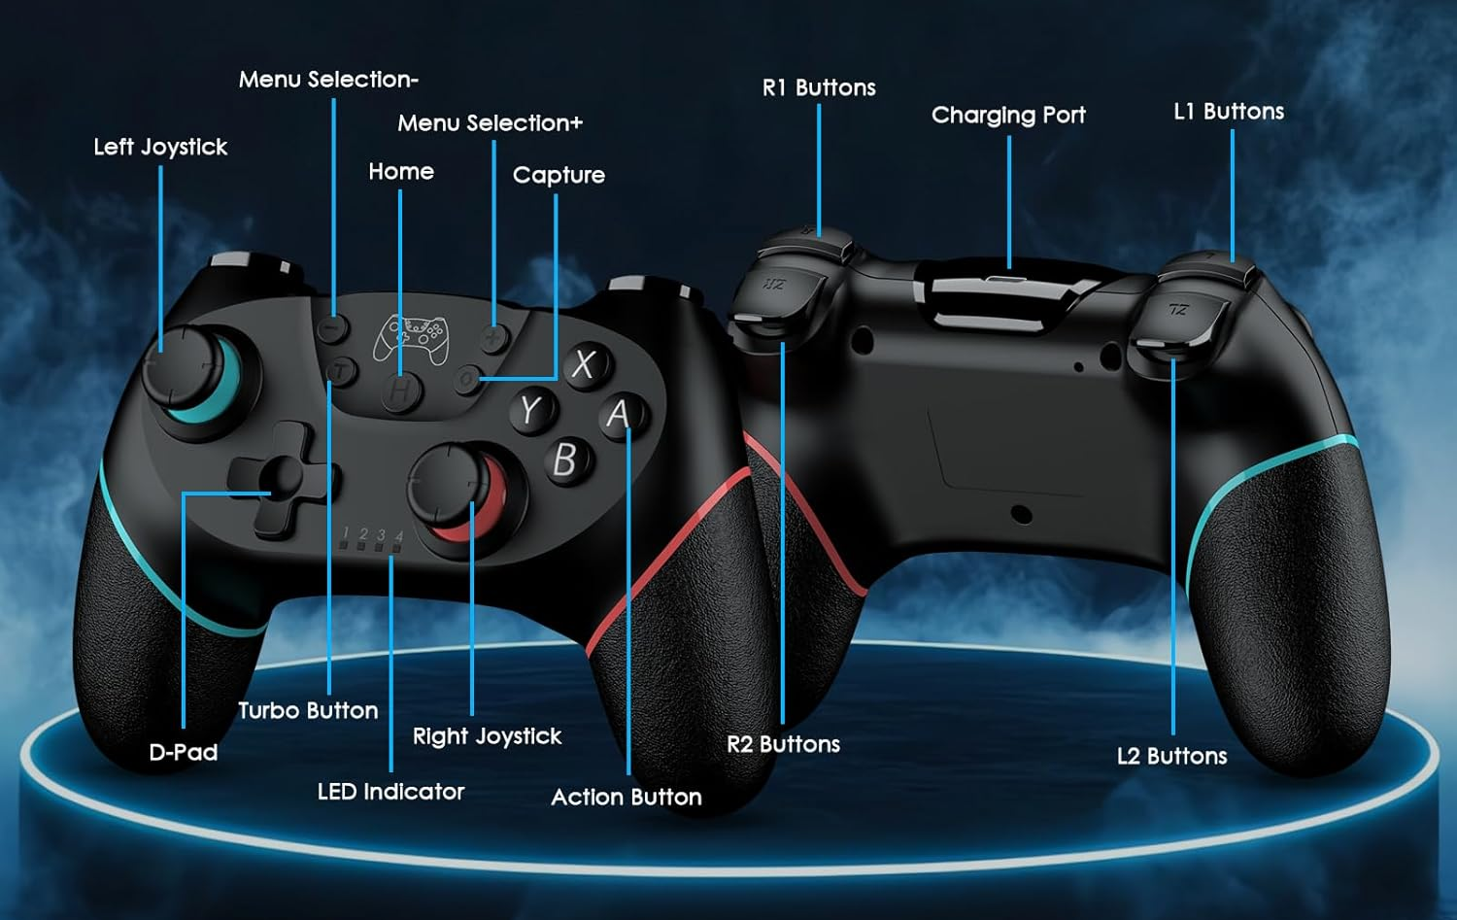
Nintendo Switch Controller

Slide 9
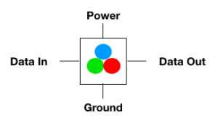
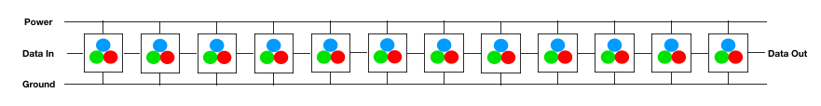
What is a Neopixel?
A Neopixel LED is an addressable LED. What does that mean? That means that each LED has a smart controller chip that allows you to send a digital message to command each LED to a given color and brightness.
Each one has a power and a ground plus they each have a “data in” and “data out” signal. A color command can be sent to the “data in” pin and the LED will pass along subsequent messages to the next LED.
When you have a strip of neopixels, they are connected together as shown in the diagram below. This allows the data to be passed all the way down the string so that every LED can be commanded. Power and ground are shared. The data out comes out of the last LED in the string and can be connected to another strip in order to continue the chain.
In theory, a neopixel string can be of unlimited length. However, the longer the string, the more data must be sent during each refresh cycle. The maximum string size is 350 LEDs for RGB or 260 LEDs for RGBW in order to maintain a 40 Hz refresh rate.

Slide 10
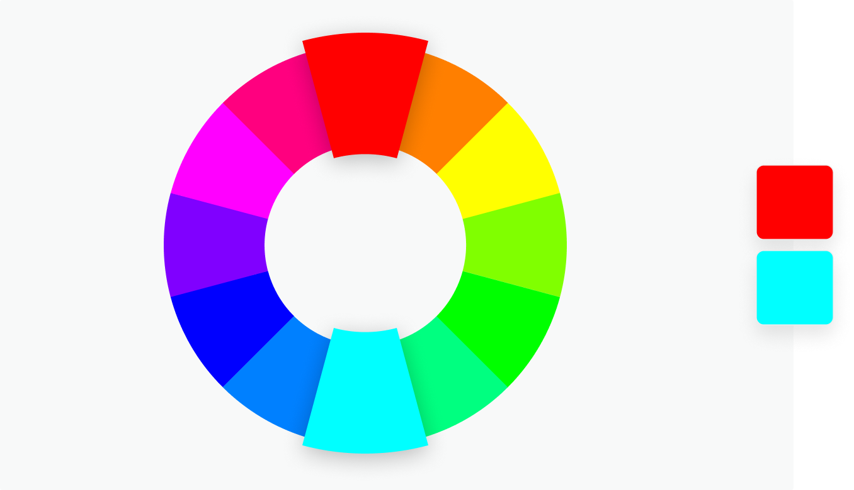
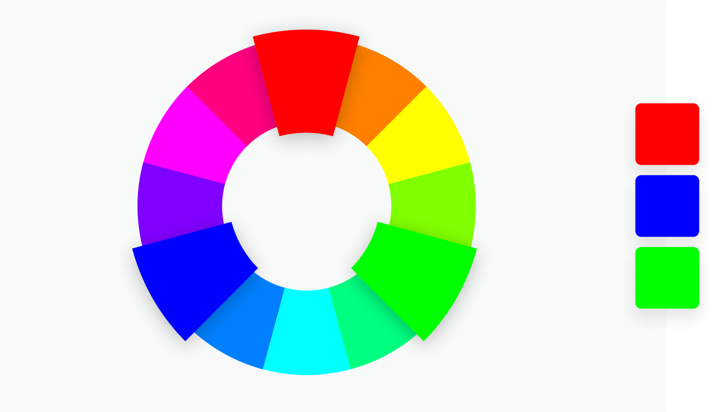
Canva Color Wheel
https://www.canva.com/colors/color-wheel/
Complementary
Two colors that are on opposite sides of the color wheel. This combination provides a high contrast and high impact color combination – together, these colors will appear brighter and more prominent.
Triadic
Three colors that are evenly spaced on the color wheel. This provides a high contrast color scheme, but less so than the complementary color combination — making it more versatile. This combination creates bold, vibrant color palettes.
Red
RGB (TV) Vs MCY (Printer)
625-740 nanometers
590-625
Magenta
Yellow
380-440
565-590
500-565
440-485
Blue
Green
Cyan
485-500
Traffic Light GYR

Slide 11
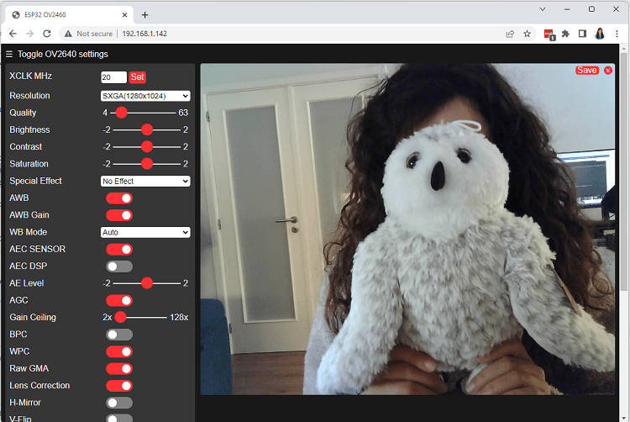
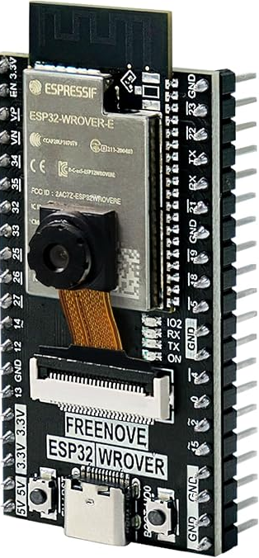
Freenove ESP32-Wrover CAM Board

Slide 12
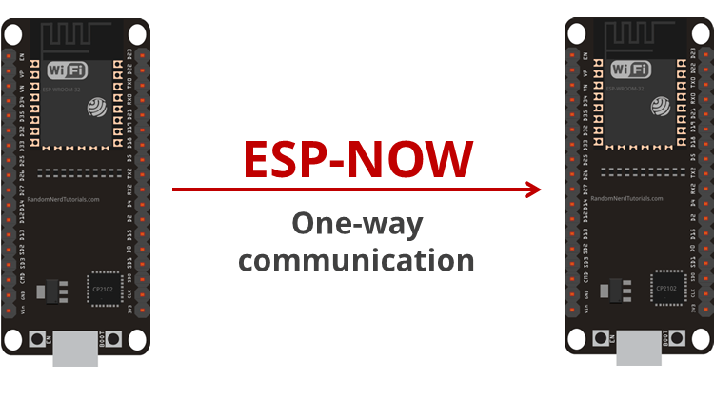
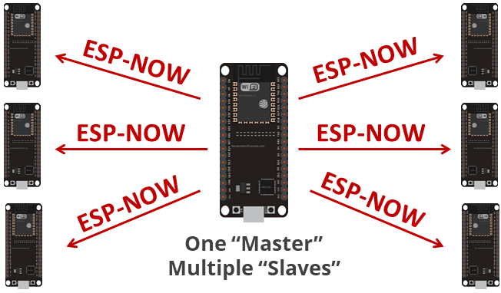
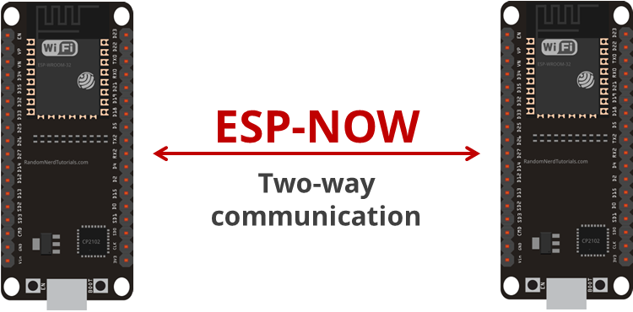
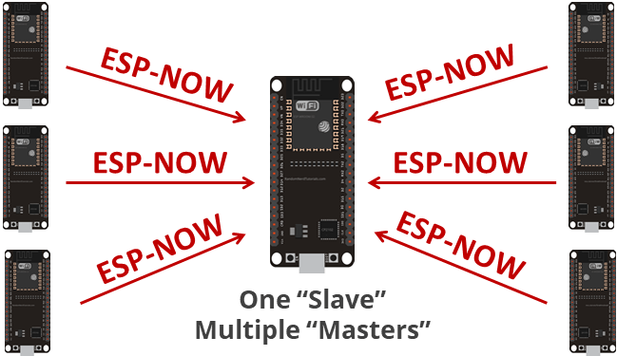
ESP NOW
Introducing ESP-NOW 5 min https://randomnerdtutorials.com/esp-now-esp32-arduino-ide/

Slide 13
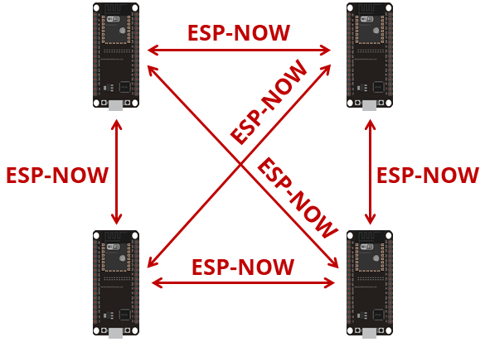
ESP NOW
Target
Pathfinder
Vehicle 1
Pathfinder
Vehicle 3
Pathfinder
Vehicle 2
Pathfinder
Vehicle 4
Base Station
Pathfinder
Vehicle 5
Base Station
Personal
Computer
Introducing ESP-NOW 5 min https://randomnerdtutorials.com/esp-now-esp32-arduino-ide/

Slide 14
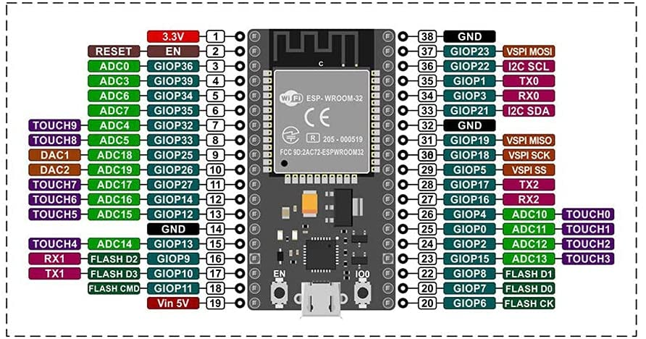
ESP32-Wroom-32E Pinout
SD0
SD1
CLK
Enable Micro USB Boot

